Slide 1
Android Development
Android Studio, Activities & Fragments

Slide 2
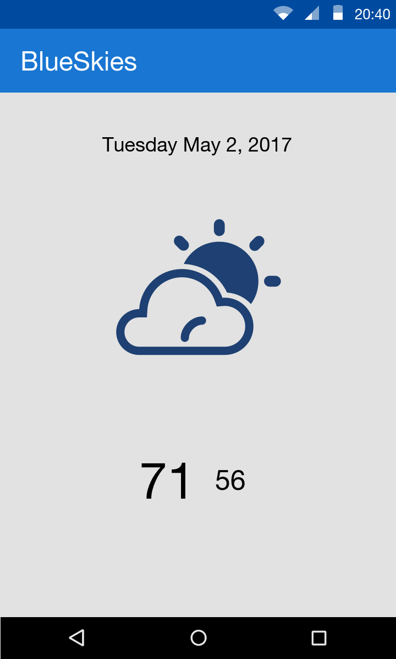
Goals
Develop a BlueSkies App
Activity
Fragment
Layout
Services
Http communication

Slide 3
What is Android
Google mobile SDK
Written in Java
Now supports Kotlin

Slide 4
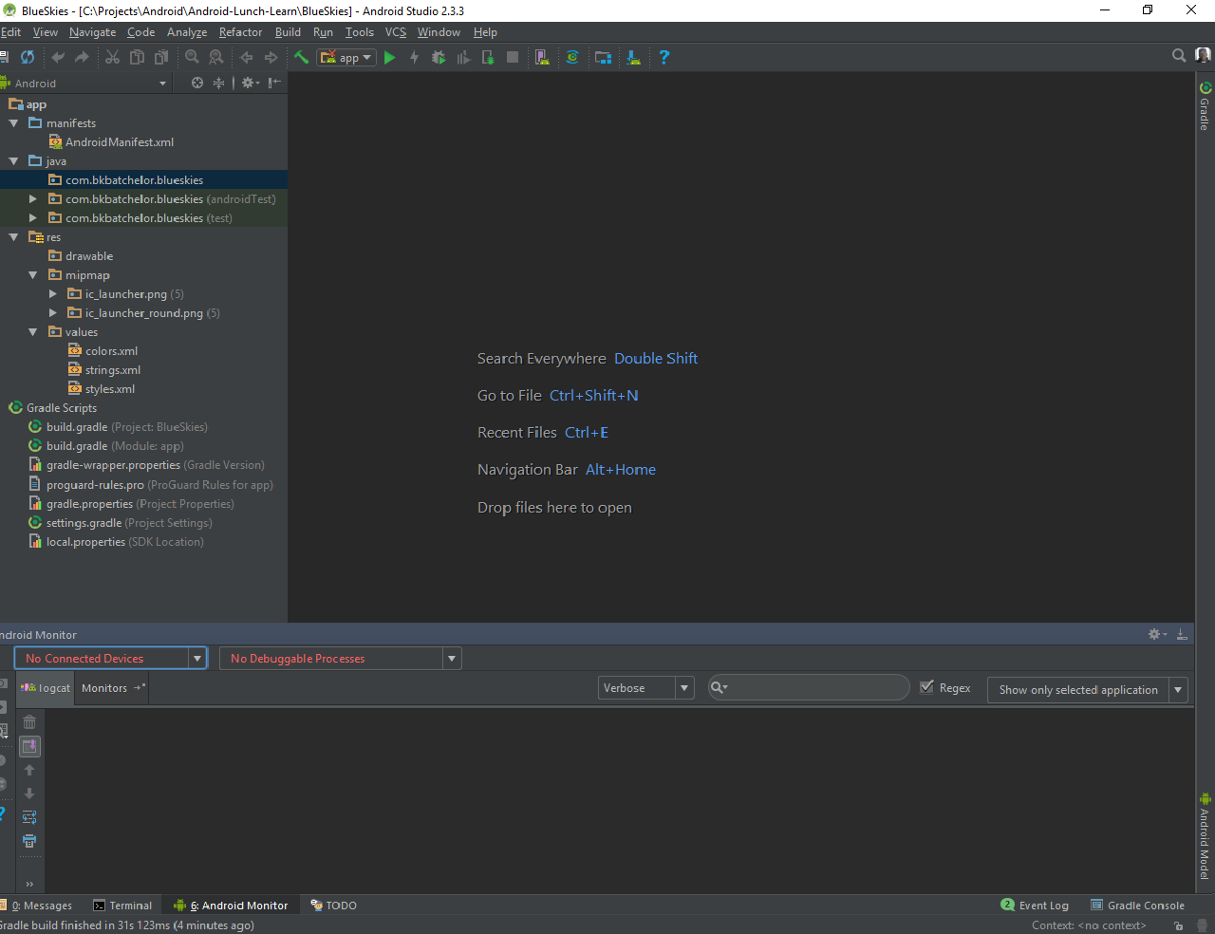
Android Studio
De facto standard for Android development
Built on the IntelliJ
Some features
Layout Editor
Built in emulator
Gradle integration
Instant Run (Hot swap)
https://developer.android.com/studio/index.html

Slide 5
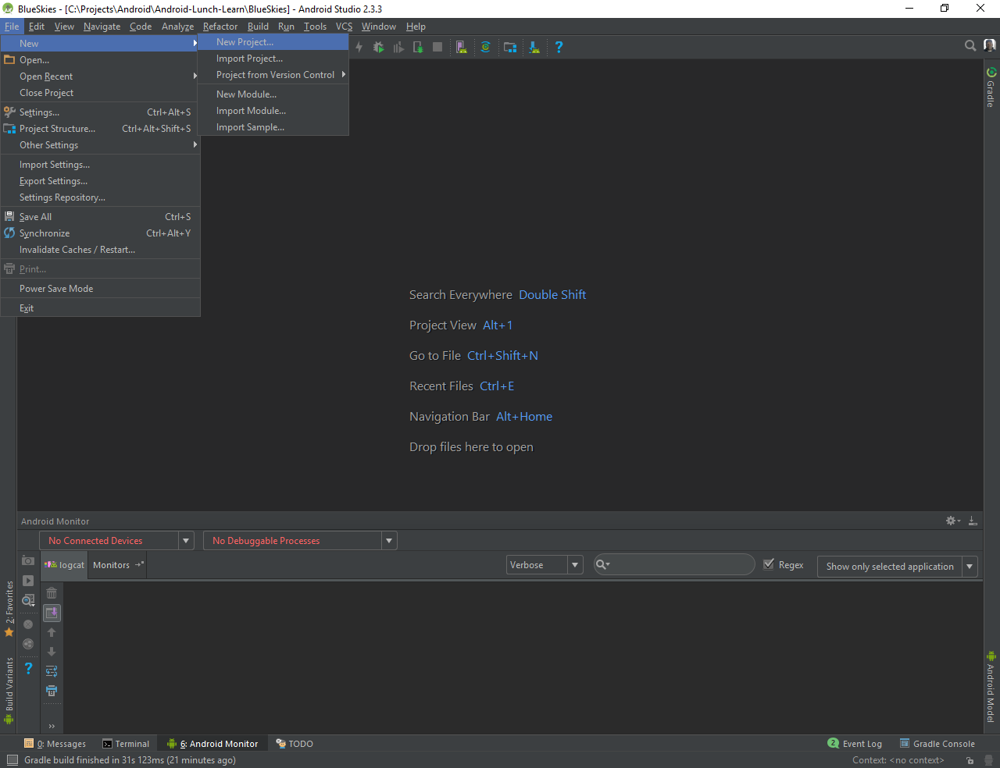
New Project

Slide 6
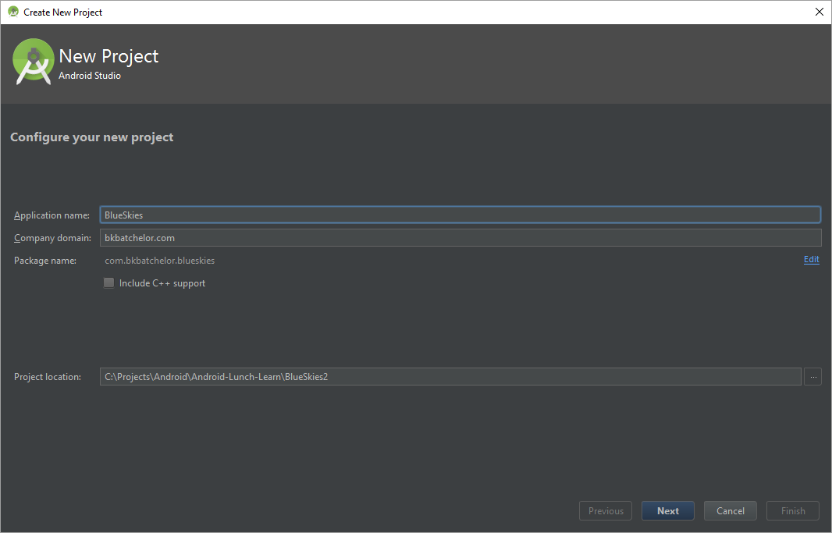
New Project (cont)

Slide 7
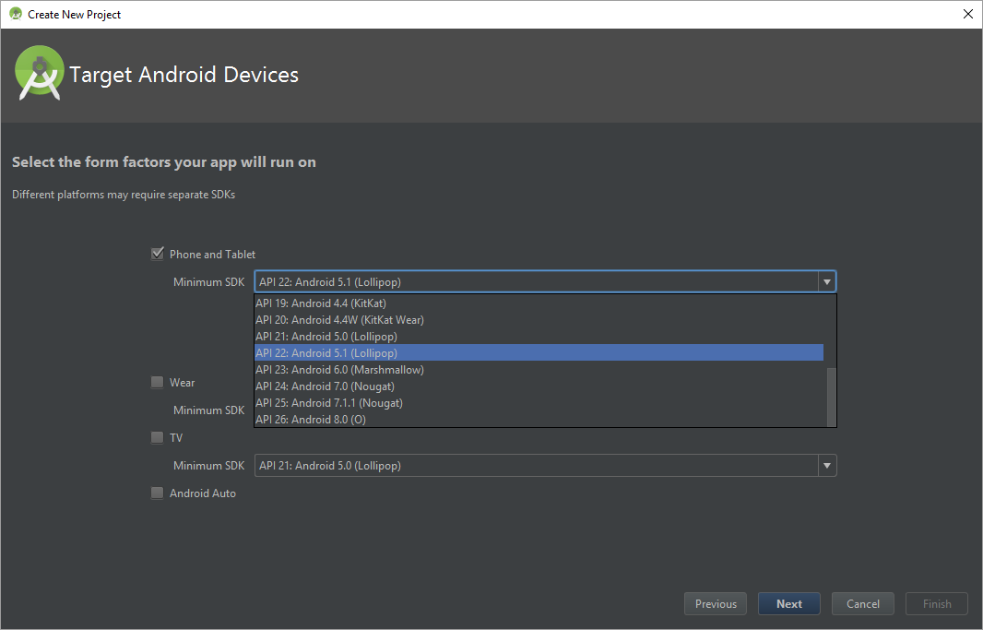
New Project (cont)

Slide 8
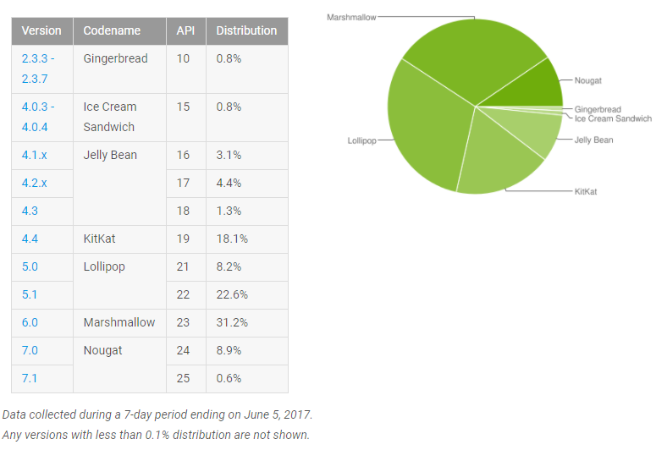
Android Versions
https://developer.android.com/about/dashboards/index.html

Slide 9
Example: Android Developer References

Slide 10
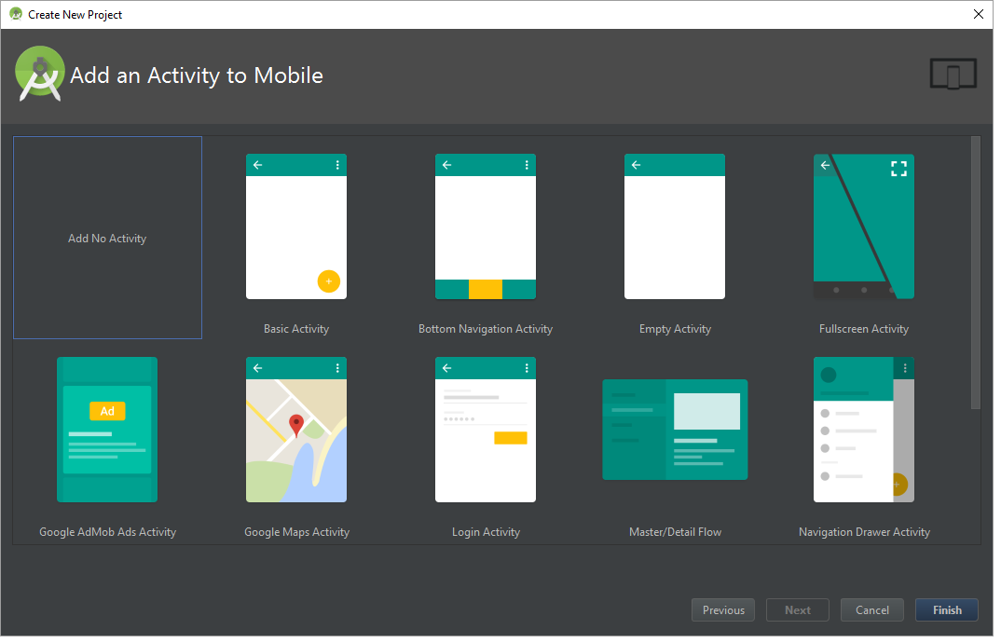
Add Activity

Slide 12
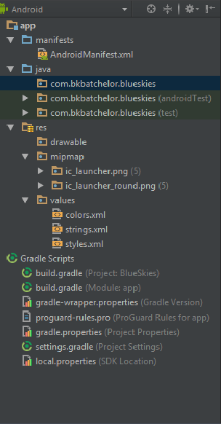

Project Pane

Slide 13
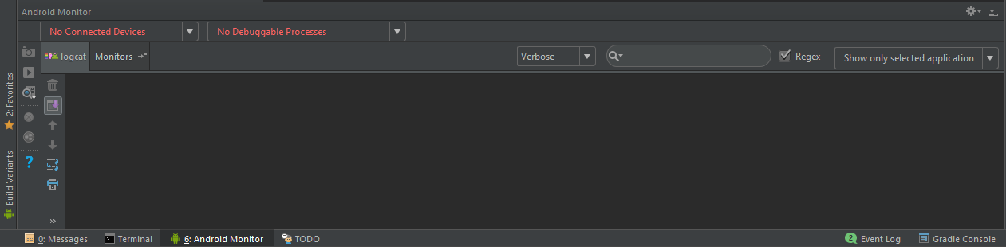
Monitoring and Logcat pane

Slide 14

Run and Debug

Slide 15
Activity

Slide 16

Activity https://developer.android.com/guide/components/activities/index.html
Fundamental building blocks
Entry point for user's interaction
Provides navigates within an app
Communication between other activities
Communication between child fragments
No Creation or Modification of Views

Slide 17
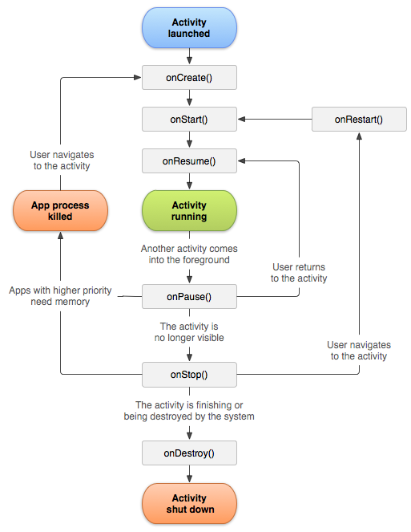
Activity Lifecycle
onCreate() started, but not visible
onStart() visible, but not ready for interaction
onResume() moved to the foreground and ready for interaction
onPause() moving to the background and stopping user interaction
onStop() moved to the background and not visible
onDestroy() moved to the background, not visible and flagged to be destroyed by the system

Slide 18

Lifecycle relationships
onCreate
onDestroy
Initialize variable
onStart
onStop
Register components (i.e. broadcast receivers)
Unregister components
onResume
onPause
Remove listeners
Set listeners (i.e. click or change)
Save data (i.e. database)

Slide 19
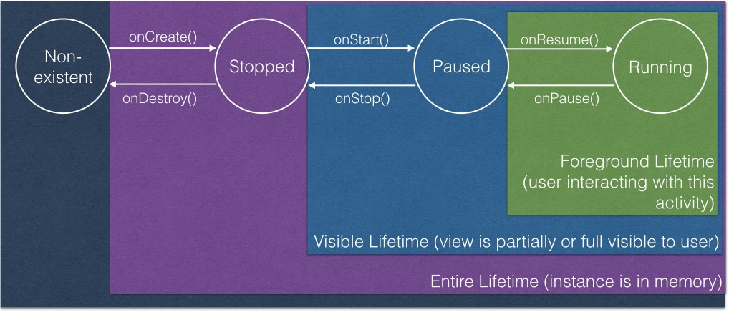
Activity’s States
Kristin Marsicano
Fragmented Podcast: Episode 76 (Taming the activity lifecycle)

Slide 20
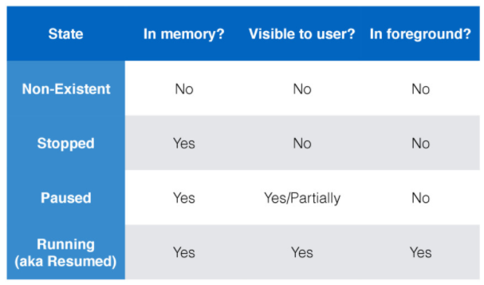
Activity’s States
Kristin Marsicano

Slide 21
Creating MainActivity
Exploring build.gradle file
Set target SDK version
Set minimum SDK version
Define dependencies

Slide 22
Creating MainActivity
Best Practices
Keep lifecycle methods in order
Place other methods (helpers) below the lifecycle methods

Slide 23
Creating MainActivity
Add XML layout
Best practices
Layout naming convention same as the activity
MainActivity.java => main_activity.xml

Slide 24
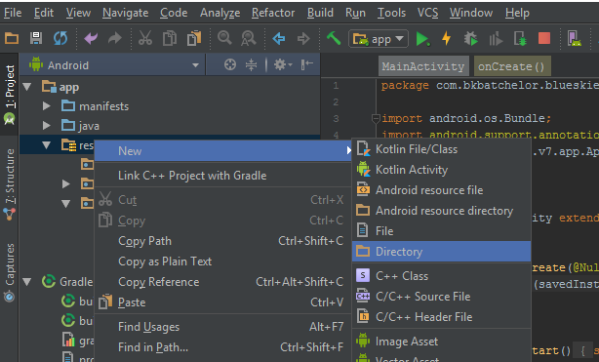
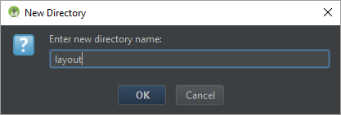
Creating MainActivity

Slide 25
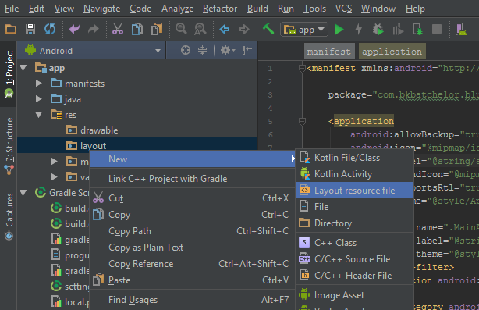
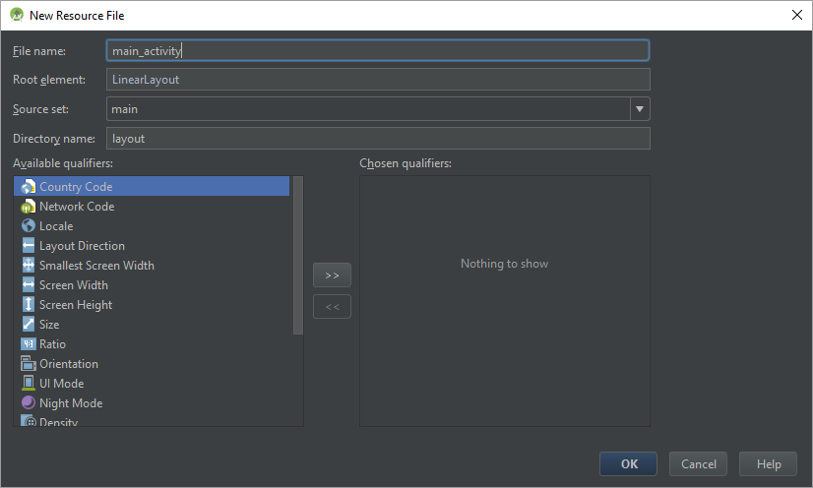
Creating MainActivity

Slide 26
Creating MainActivity Layouts
Types of layouts
Linear
Relative
Frame
Constraint
Best Practices
Attempt to keep the layout flat by avoiding nest layouts

Slide 27
Creating MainActivity
Link Activity to Layout

Slide 28
Creating Fragments

Slide 29
Creating MainActivity Density Independent Pixel (dp)
Density Independent Pixel (dp)
View Groups and View dimensions
Scale according to screen density, not screen size

Slide 30
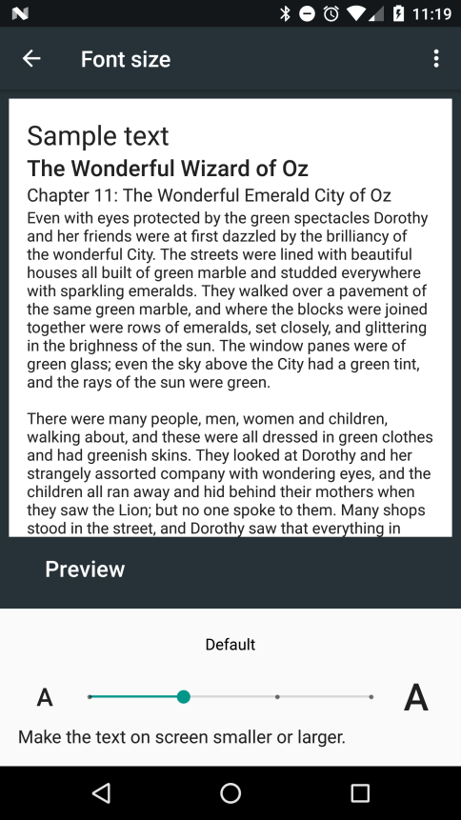
Creating MainActivity Scale Independent Pixel (sp)
Scale Independent Pixel (sp)
text size
Scale according to screen density, not screen size
Also, scales according settings font settings

Slide 31
Creating MainActivity
Add MainActivity to AndroidManifest.xml
The manifest file provides essential information about your app to the Android system, which the system must have before it can run any of the app's code. (i.e. activities, services, content provider…)

Slide 32
Fragment
View and Layout logic
Event handling (i.e. onClick())
Network request
Interacting with a persistence storage

Slide 33
Detail Level

Slide 34
Activity Lifecycle counterparts
OnCreate()
OnDestroy()
onStart()
onStop()
onResume()
onPause()

Slide 35
Activity Lifecycle
onRestart() activity is stoppd, then started again

Slide 36
Hitting back
onDestroy()

Slide 37
Home button
Stopped

Slide 38
SavedInstanceState
On Rotation
App is killed

Slide 39
Github

